Slide 1
LEEDS DEVOPS
DeVOPS != TOOLS
PHPNW14 – OCTOBER 4th 2014

Slide 2
EYUP
By day
  @andyburgin
  SKYBET
By Night
  @leedsdevops
Notes:
Introductions
Day Job
15 years
Development
Operations
Infrastructure
Project Management
Business Processes
started leeds devops last year
4th meetup next month
Speakers from SkyBet, Orange Digital, Sage and Canonical
YOU MUST BE DRUPAL YORKSHIRE – HOW DO YOU DO

Slide 3
TOOLS, TOOLS, TOOLS
VC - GIT, Github, SVN, Mercurial,
IAC/CI/CD - Jenkins, Chef, Puppet, Octopus
Monitoring - Nagios, Sensu, Zabbix
Metrics - Graphite, Munin, SPLUNK
Orchestration - Rundeck, Zookeeper
Sharing - Wiki, JIRA, beer
Notes:
Creation and Exploitation of tools – e.g IAC + Vagrant
Be careful - don’t use the wront tools, doing the wrong thing
right makes things worse
Ask yourself “why” do you want to use the tools, what are
they contributing to business value
Don’t rely on the tools - CAMS - Just doing the tools doesn’t
mean you are doing devops
The easy wins - How I got into devops - we were using tools

Slide 4
TOOLS, TOOLS, TOOLS
As devs We all love them
Gateway drug
16:20 – Modern developer toolbox
papblo godel
Notes:
The title of the talks was about making “better” software

Slide 5
DevOps the problem sphere
Devops is a business problem
But that's not my problem
It's not my fault
And another thing tools are my problem
Notes:
….errr, wrong crowd

Slide 6
Structured to fight
ACME Software
Marketing
Operations
Finance
Dev
Ops
Notes:
Bus Problem
Start with Why
Techies v financial savy
Structure
Budgets
Silos
KPIs
Bonuses
EMPIRE
Infighting

Slide 7
Flow
ACME Software
Marketing
Operations
Finance
Dev
Ops
Requirements
Software
Services
Customers
Notes:
How do we make money
Flow in a service organization
agile transformed the software development world - making it
easier to change focus and deal with business requirements
Business cant deploy changes fast enough
The bottleneck of requirements changed removed from DEV, now
operations is a bottleneck
Lets have a slice of Agile in ops

Slide 8
LEARNING FROM THE PAST
How do we remove the bottleneck
Manufacturing had all these problems 100 years ago
operations management
Systems Thinking
theory of constraints
Toyota production system
Notes:
Business is making services - ops is a bottlekneck
Manufacturing production lines suffered from bottlenecks, inaficiencies and intra skill bases
Theres a whole science around making “operations” work better - how they run
Operations Management
Product and Service Development
Project and Portfolio management
Process Management/Measurement
Financial Analysis
Quality Management
Scheduling
…and loads more
There’s a load of work been done in the last 100 years by lots of clever people…..
Japanese manufacturing processes, Theory of constraints and TPS - 1973 oil crisis
3 most prominent
Systems thinking - seeing the whole picture and identifying it’s parts
So we can learn from TOC identify bottlenecks - Keep the flow going
Use TPS to change the approach and processes

Slide 9
LEAN
Muda - non value waste
Kaizen - continuous improvement
Jidoka - Automation
Polka yoke - Mistake proof
5S - Sorting, simplifying, Sweeping, standardising & sustaining
5 Why
Notes:
removing things from the process that provides
no customer value - value chain

Slide 10

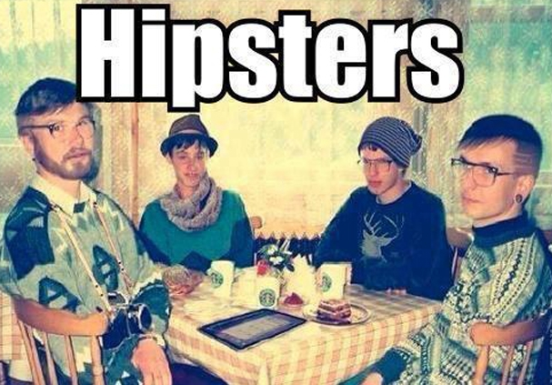
It's a People problem too
Notes:
Illustrated example
Wall of confusion / GAP
Responsibilities
Whos wall is it anyway
Whos wall is it, is it to sheild the devs from worrying about NFR
Is it there to keep the ops NFRS becoming their problem

Slide 11
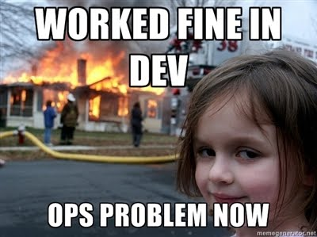

Put it another way...
W
A
L
L
Notes:
Illustrated example
Wall of confusion / GAP
Responsibilities
Whos wall is it anyway
Whos wall is it, is it to sheild the devs from worrying about NFR
Is it there to keep the ops NFRS becoming their problem

Slide 12
DevOps is...
“Devops means giving a s#!t about your job enough to not pass the buck. Devops means giving a s#!t about your job enough to want to learn all the parts and not just your little world...”
Notes:
Improving how teams work together and
valuing the contributions the team makes

Slide 13
DevOps is...
“…developers need to understand infrastructure. Operations people need to understand code.
People need to f#*&ing work with each other and not just occupy space next to each other.”
John E VINCENT (@LuSis)
Notes:
Improving how teams work together and valuing
the contributions the team makes

Slide 14
Cams definition
Culture
Automation
Measurement
Sharing
Notes:
…so before I went all opsy and managerial we defined devops
Daemon edwards john willis
It’s all about the culture - shared attitudes, values goals and practices
You’re defining the “why” - get that right
Be careful how you change it - everyone needs to want to change
start small, continual improvement - Kaizen
Cant be forced top down - real big deal.
People are averse to change
Attitudes to change
Word of warning if you haven’t got the culture right implementing some of the
facilitating tools could make things a whole lot worse

Slide 15
CAMS - Culture
Communicating & Working together
exchange ideas
pride in WORKMANSHIP
Shared responsibilities
Value each others roles
FUN
Notes:
Braking the silos is the key
Collaboration - Get the teams talking, sit them together
Creating a collaboration of people and a convergence of process
solve issues together or better still head problems off at the pass - all the NFR
If the guy on the next desk is the guy who has to sort out your bad code at 4am,
you might just
write better code
Might know what to fix for next time
Value and trust each others contribution to the business
Play nicely, make going to work less like going to battle

Slide 16
CAMS - Automation
Version Control
Continuous Integration
Automated Testing
Automated DEPLOYMENT
Continuous Deployment
Build Pipeline Efficiencies
Orchestration
Notes:
Borrows lots of concepts
use tools to reinforce and reflect culture
Not just Dev
Ops people code
CD Utopia – IAC version, build and test the infrastructure
Make releases simple and painless - not a big deal
Build pipeline : dev-test-uat-preprod-prod : bail out - include infrastructure
Utopia
Orchestration tools to make looking after that infrastructure simple

Slide 17
CAMS - MEASUREMENT
Measure Everything
metrics - systems
Metrics - application
Metrics - productivity
Dashboards
baselines
Notes:
If it moves graph it - data > opinion
#monitoringsucks
Centralise logging tools – help share info x-ref
Comitts, Releases, Bugs - Evaluate
Focus on effectiveness and quality - have a systems view like in operation
Management
Measure success and failure - failure is a friend - found the infrastructure
isn’t robust enough - Netflix Chaos Monkey, Pager Duty failiure friday
improve

Slide 18
CAMS - Sharing
Don’t hide Measurements
evangelise about tools
Mentoring
Skills exchange
Open Source
resources - LEARN
LeedsDevops
Notes:
Not about creating generalists
Gone to all the trouble of measuring
Don’t lock this stuff away - put it on NOC screens
Show and Tell
This is evolving - need to learn and share

Slide 19
TOOLS, TOOLS, TOOLS
VC - GIT, Github, SVN, Mercurial,
IAC/CI/CD - Jenkins, Chef, Puppet, Octopus
Monitoring - Nagios, Sensu, Zabbix
Metrics - Graphite, Munin, SPLUNK
Orchestration - Rundeck, Zookeeper
Sharing - Wiki, JIRA, beer
Notes:
Creation and Exploitation of tools – e.g IAC + Vagrant
Be careful - don’t use the wront tools, doing the wrong thing
right makes things worse
Ask yourself “why” do you want to use the tools, what are
they contributing to business value
Don’t rely on the tools - CAMS - Just doing the tools doesn’t
mean you are doing devops
The easy wins - How I got into devops - we were using tools

Slide 20
Devops != Tools
DON’T do the wrong thing right
it makes things worse(erer)
That’s why devops shouldn’t concentrate on the tools
DON’t create more bottlenecks
DON’t create more silos
Business value
Notes:
Be careful - don’t use the wrong tools, doing the wrong thing
right makes things worse
JOSH and BEN example
Ask yourself “why” do you want to use the tools, what are
they contributing to business value

Slide 21
Leeds DEvops
We'll talk to you
Meet Monthly(ish)
help - promotion/speakers/sponsors

Slide 22
QUESTIONS
OWT ?
leedsdevops.org.uk
info@leedsdevops.org.uk
@leedsdevops
https://groups.google.com/d/forum/leedsdevopS
https://github.com/leedsdevops

